Slide 1
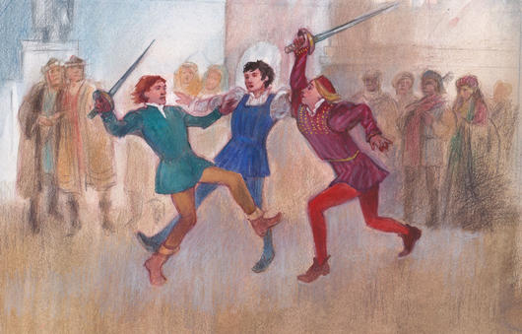
Act 1, Scene 1: Exposition
Stop in the name of love!
He started it!
But he bit his thumb at me!
We have already seen how the play opens in the prologue, with key themes such as love and hate introduced to the audience by the chorus. We have also seen the use of ANTITHESIS in the prologue to encapsulate this key opposition in the play. We now plunge into an opening scene of VIOLENCE on the streets of Verona.

Slide 2
A Divided City
Stop in the name of love!
Romeo and Juliet I 1 Zeffirelli
He started it!
But he bit his thumb at me!
What can we infer about Gregory and Sampson from the way they talk?
What is their attitude towards women? (line 13)
What contrast is established between Benvolio and Tybalt upon their entrances? (line 49)
What can the audience infer from the citizens reactions to the brawl? (line 64)
What do we learn about the parents of the families? (line 65)

Slide 3
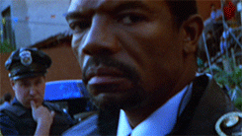
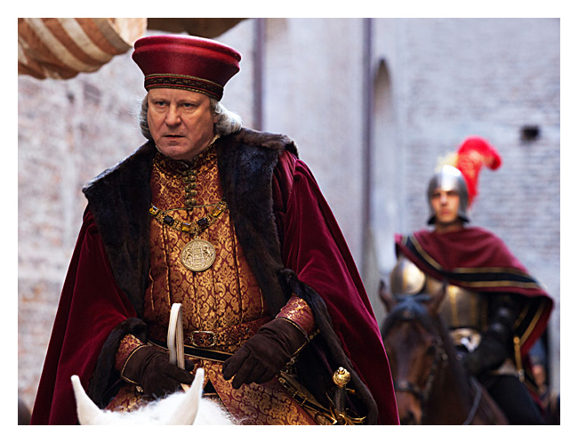
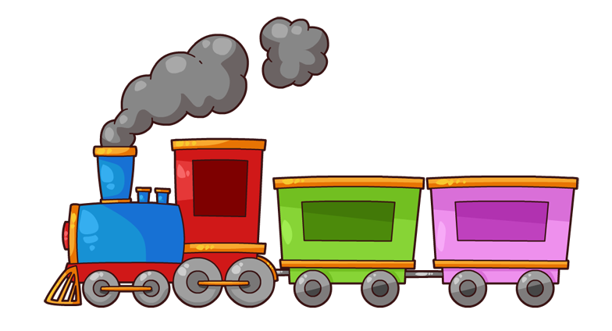
Enter Prince Escalus(with his train)
You are Prince Escalus.It is your job to keep peace in the City of Verona.
How would you be feeling at this moment. Why?
In your groups, divide up the speech and practice reading it aloud trying to capture this feeling.
Highlight/annotate a piece of imagery you find interesting in this speech. Be prepared to discuss.

Slide 4
Watch then re-read the Prince’s speech after Act 1’s opening fight scene:
Romeo and Juliet I 1 Zeffirelli (watch from 6mins in to end)
The label ‘Profaners’ confirms the Capulets and Montagues are defying the law and authority by fighting in public. ‘Neighbour-stained steel’ evokes connotations of blood and murder. ‘Neighbour’ usually has friendly connotations but ‘stained’ references bloodshed on the ‘steel’ swords
PRINCE Rebellious subjects, enemies to peace,
Profaners of this neighbour-stained steel,--
Will they not hear? What, ho! you men, you beasts,
That quench the fire of your pernicious rage
With purple fountains issuing from your veins,
On pain of torture, from those bloody hands
Throw your mistemper'd weapons to the ground,
And hear the sentence of your moved prince.
Three civil brawls, bred of an airy word,
By thee, old Capulet, and Montague,
Have thrice disturb'd the quiet of our streets,
And made Verona's ancient citizens
Cast by their grave beseeming ornaments,
To wield old partisans, in hands as old,
Canker'd with peace, to part your canker'd hate:
If ever you disturb our streets again,
Your lives shall pay the forfeit of the peace.
For this time, all the rest depart away:
You Capulet; shall go along with me:
And, Montague, come you this afternoon,
To know our further pleasure in this case,
To old Free-town, our common judgment-place.
Once more, on pain of death, all men depart.
Animalistic connotations of ‘beasts’- implies they act with no polite respectability and only with base passion and fury
This imagery evokes connotations of passion - their feud is alive and only violence will ‘quench’ their thirst for ‘fire’.
This metaphor creates the impression that blood is spilling over in unstoppable ‘fountains’ and it symbolises their unending violence and hatred for one another
‘The quiet of our streets’ implies that without the Capulets and Montagues, this would be a peaceful, content city, but they have now created public conflict three times - the Prince seems tired of this fued and his anger is evident in his commanding tone of voice
The symbol of ‘hands’ is used throughout the play as a recurring motif - here it is used to suggest their hands are unclean and tainted with violence and hatred
Repeated reference to ‘hands’ - he suggests the feud has roused older citizens too, involving all generations - he suggests they should know better. The repetition of ‘canker’d’ implies this is a poisonous and infectious feud.
This is a threat and warning from the Prince - he conveys the extreme penalty of death if there is further fighting in public- this is an important plot device, foreshadowing the later conflict between Romeo and Tybalt in Act 3.

Slide 5
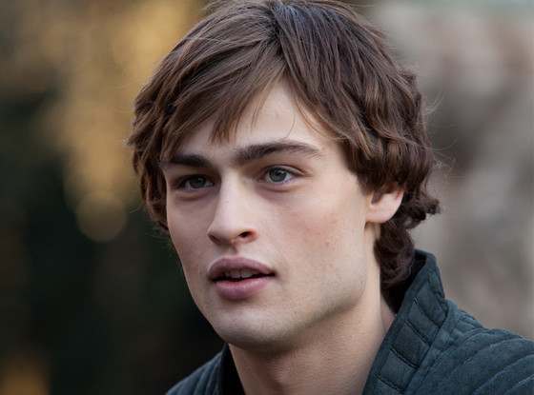

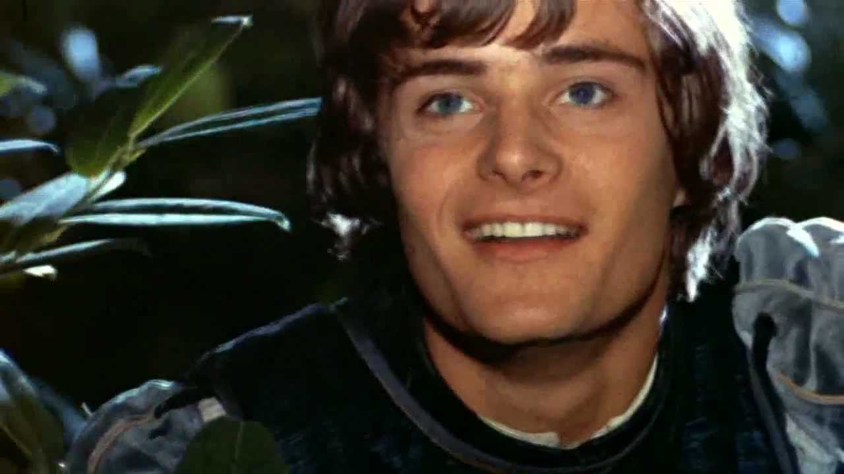
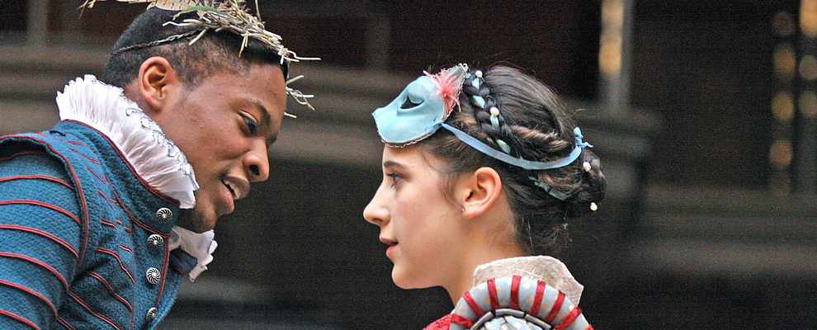
Key Question:
How does Shakespeare introduce Romeo at the start of the play?

Slide 6
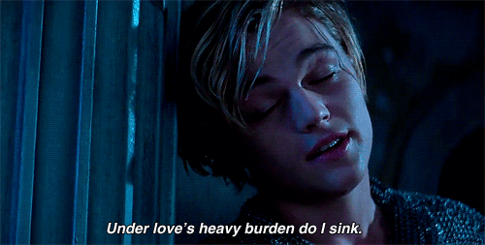
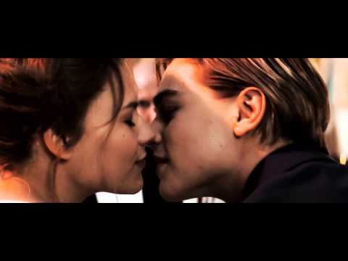
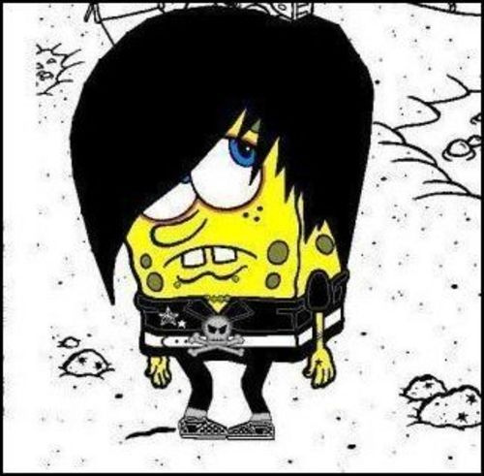
Benvolio:
So early walking did I see your son.
Towards him I made, but he was ‘ware of me
And stole into the covert of the wood.
How is Romeo presented before we meet him?
Rom-emo, Rom-emo, wherefore art thou, Rom-emo?
Montague:
Many a morning hath he there been seen,
With tears augmenting the fresh morning’s dew,
Adding to clouds more clouds with his deep sighs.
Cheeky Titanic reference?
Montague:
Away from light steals home my heavy son,
And private in his chamber pens himself,
Shuts up his windows, locks fair daylight out,
And makes himself an artificial night.
Notes:
What can we interpret from these quotes?

Slide 7
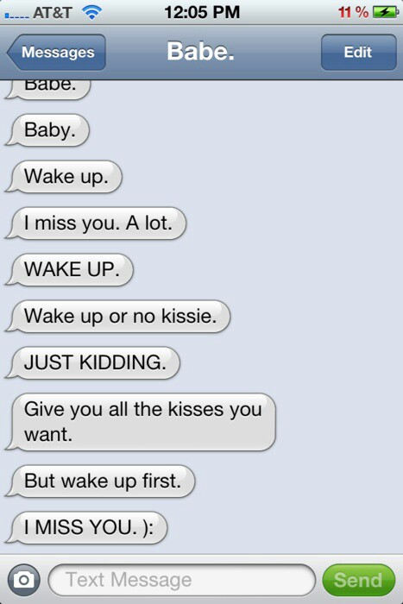
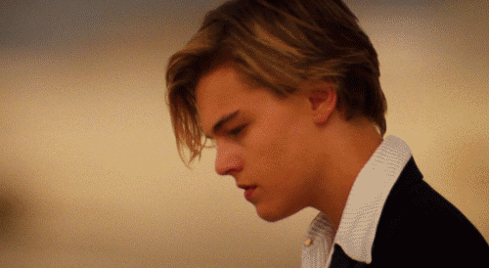
Act 1, Scene 1: Romeo and Love
Romeo is “lovesick”
But...what even is love?

Slide 8
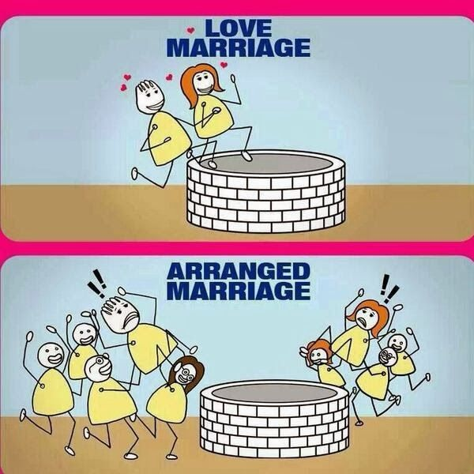
Act 1, Scene 1: Romeo and Love
What is Love in 2023?
In our culture we’re accustomed to the notion that marriage is based on romantic attachment resulting from physical attraction and intimacy. Love is a prelude to marriage- a legally recognised status (but only for hetrosexuals until recently). One ‘rule’ is that we remain monogamous.
Where do we see this in the play?
However, this hasn’t always been the case, and as we know from living in a multicultural society, people from other cultural traditions have different attitudes to marriage and relationships between the sexes.
Arranged marriages based on money, land and power used to be common place among the ruling classes - ‘love’ didn’t come into the equation.

Slide 9
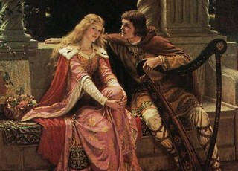
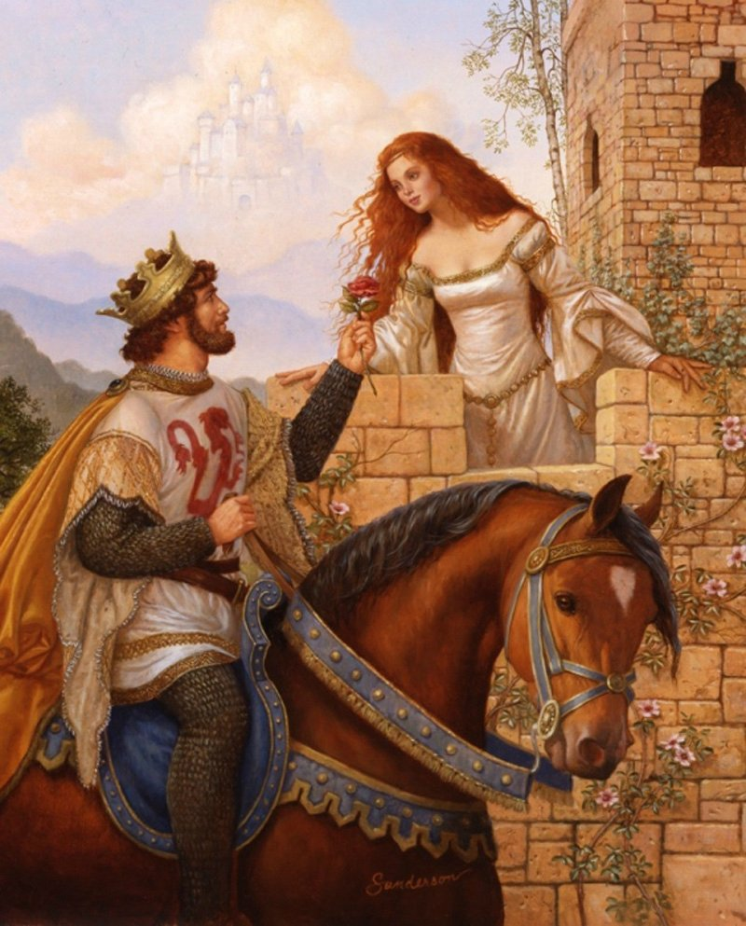
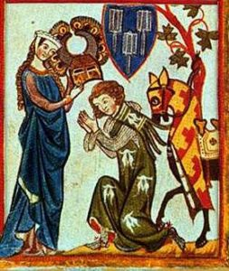
Act 1, Scene 1: Romeo and Love
What was love in the past?
Courtly Love was a medieval tradition in which members of the upper class engage in love affairs according to specific rules of behaviour.
The phrase "courtly love" is a modern scholarly term to refer to the idea espoused in medieval French as "Fin Amour." This phenomenon is a cultural trope in the late twelfth-century, or possibly a literary convention that captured popular imagination.

Slide 10
The Rules of Courtly Love (Fin Amour)
The violence and wars of the Middle Ages were tempered by the Rules of Courtly Love. The following rules and elements of Courtly Love during the Middle Ages were written by the 12th Century Frenchman, Andreas Capellanus:
Can you summarise the principles of courtly love in less than 30 words?
No one can be bound by a double love
It is well known that love is always increasing or decreasing
That which a lover takes against the will of his beloved has no relish
Boys do not love until they arrive at the age of maturity
When one lover dies, a widowhood of two years is required of the survivor
No one should be deprived of love without the very best of reasons
No one can love unless he is impelled by the persuasion of love
Love is always a stranger in the home of avarice
It is not proper to love any woman whom one would be ashamed to seek to marry
A true lover does not desire to embrace in love anyone except his beloved
When made public love rarely endures
The easy attainment of love makes it of little value; difficulty of attainment makes it prized
Every lover regularly turns pale in the presence of his beloved
When a lover suddenly catches sight of his beloved, his heart palpitates
A new love puts to flight an old one
Good character alone makes any man worthy of love
If love diminishes, it quickly fails and rarely revives
Jealousy, and therefore love, are increased when one suspects his beloved
He whom the thought of love vexes eats and sleeps very little
Every act of a lover ends in the thought of his beloved
A true lover considers nothing good except what he thinks will please his beloved
A lover can never have enough of the solaces of his beloved
A slight presumption causes a lover to suspect his beloved
A man who is vexed by too much passion usually does not love
A true lover is constantly and without intermission possessed by the thought of his beloved
Nothing forbids one woman being loved by two men or one man by two women
Notes:
http://www.lordsandladies.org/courtly-love.htm

Slide 11

Male Expectations
Fall in love with a women of higher social class, possibly married, so she is unattainable
Suffer continually from jealous thoughts
Perform deeds to make himself seem more worthy in front of his lady
Have faith in the power of God to help with the problem
Be consumed with passion, melancholy, grief
Be unable to eat or sleep
Make up verses and songs about the dilemma

Slide 12

Female Expectations
Only be chosen a suitably rich and powerful husband – an ally for the family
Spurn the man’s advances in order to preserve her honour and good name
Get married at age fourteen or fifteen
Have no say in the choice of husband
Be cold with the man in order to inflame his passion

Slide 13
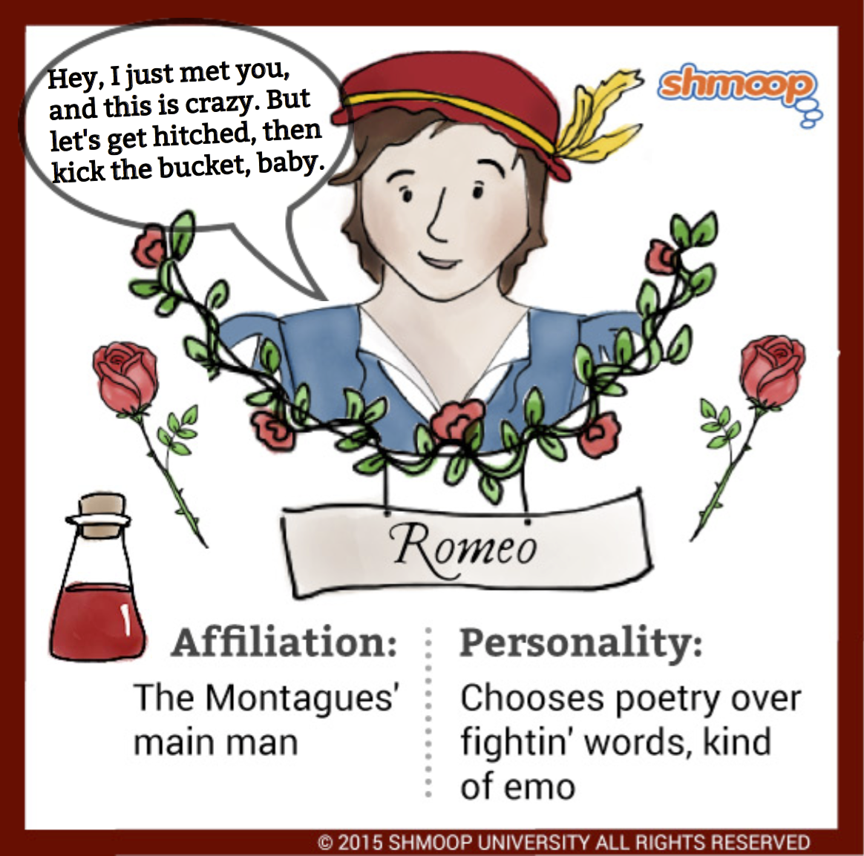
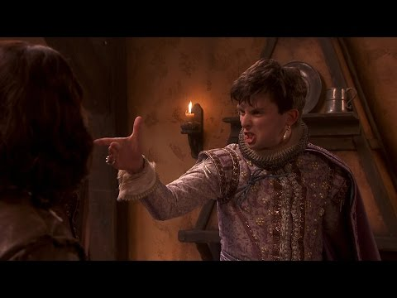
Act 1, Scene 1: Romeo and Love
The ‘Petrarchan’ Lover believes that:
the woman is a 'lady', 'mistress', 'goddess'. In the fantasy world of the poem, she is powerful and in control. This is an interesting reversal of the actual conditions in this time period where men were in charge and women were property of either their fathers or husbands.
to love is to suffer - to the extreme. This passion consumes. Words like 'woe' and 'despair' abound.
courting is dramatised as a chase: the man pursues, the woman flees.
A* Level
Context
Knowledge!

Slide 14
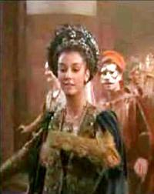
Act 1, Scene 1: Romeo and Love
Who is the character of Rosaline? Why do we never see or hear from her?
She is an unseen character.
How do Romeo and Rosaline conform to the notions of courtly love?
Notes:
Rosaline- she is as absent as Romeo’s genuine love.

Slide 15
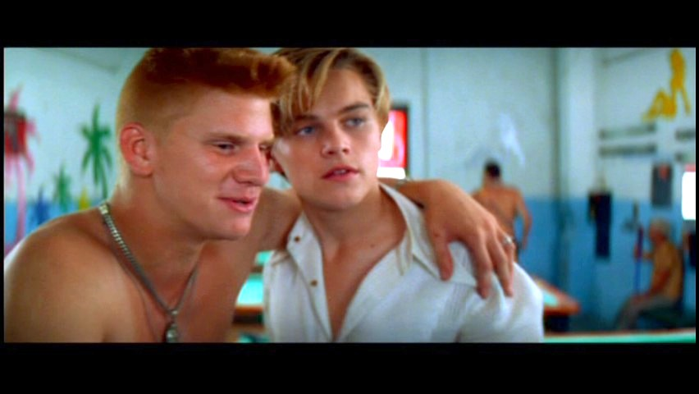
In pairs, do your best emo teen impression and read aloud up to line 160 and then the following monologue:
How is Romeo introduced through his conversation with Benvolio?
Rom-emo, Rom-emo, wherefore art thou, Rom-emo?
Alas, that love, whose view is muffled still,
Should, without eyes, see pathways to his will!
Where shall we dine?—O me! What fray was here?
Yet tell me not, for I have heard it all.
Here’s much to do with hate but more with love.
Why then, O brawling love, O loving hate,
O anything of nothing first created!
O heavy lightness, serious vanity,
Misshapen chaos of well-seeming forms!
Feather of lead, bright smoke, cold fire, sick health,
Still-waking sleep, that is not what it is!
This love feel I, that feel no love in this.

Slide 16
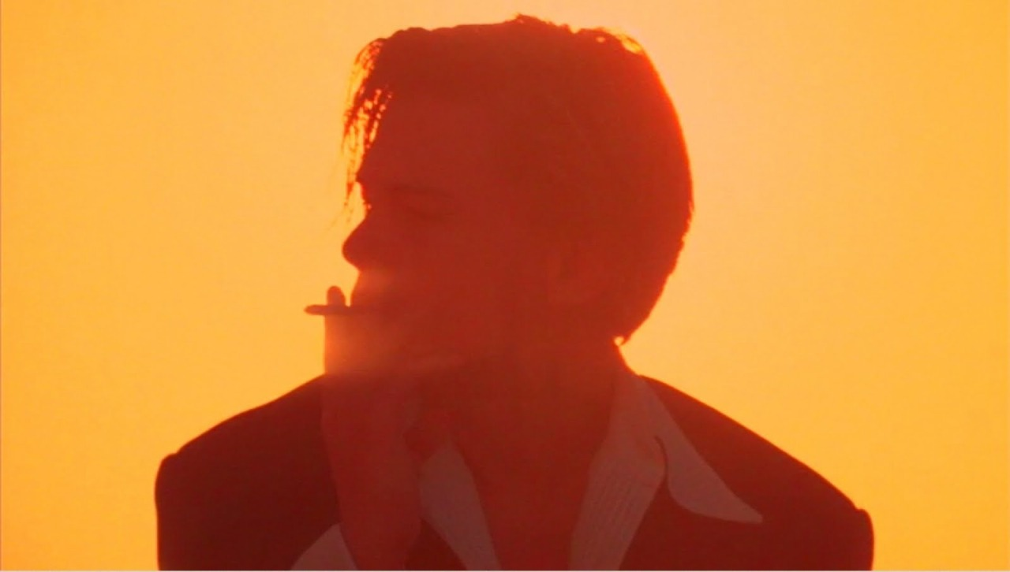
Act 1, Scene 1: Romeo and Love
Task: Using your highlighter, what oxymoron can you find in his speech? Highlight and label them.
1: Which oxymoron do you think is the most effective?
The oxymoron I think is the best is… “_______”
I think this because it describes….
2: Why do you think he has used so many oxymorons in his speech?
3: What do you think Romeo is saying about how love works? Do you agree?
EXTENSION:
4. What imagery does Romeo use to describe love in lines 176-185. What is he saying about love?
5.How are ideas of the petrarchan lover and courtly love shown in the rest of this scene?
6. What is Benvolio’s advice to Romeo and why does he reject it?

Slide 17

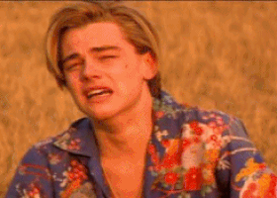
Conclusion:
Wherefore does Shakespeare present Romeo like this?
(note: this is not the same question as ‘wherefore is Romeo sad’)
Notes:
https://docs.google.com/document/d/1mIg7riGhOC-mWT_fKjynsGpU8CuxGdP5EIuf_iYlJK4/edit
Shakespeare is deliberately parodying/pastiching the form of romantic love familiar to audiences through conventional and cliched- but popular- sonnet forms of the time. He mixes this up later to show Romeo’s ‘real’ love for Juliet and his maturing sense of poetic identity.

Slide 18
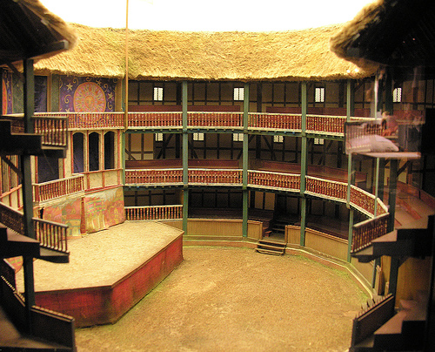
Shakespeare’s Globe
The Galleries
This is where the wealthier people would have sat: intellectuals, nobles etc. These people would likely have read lots of poetry and seen lots of plays.They were the cultural elite of their time.
Note…
We’re going a bit deeper here….prepare for some higher-level analysis.
The Pit
This is where the ‘groundlings’ will have stood for the performance. They were often quite unruly. Entrance would be relatively cheap.
Notes:
From their point-of-view of Shakespeare’s, what would different members have gainedfrom A1S1?

Slide 19
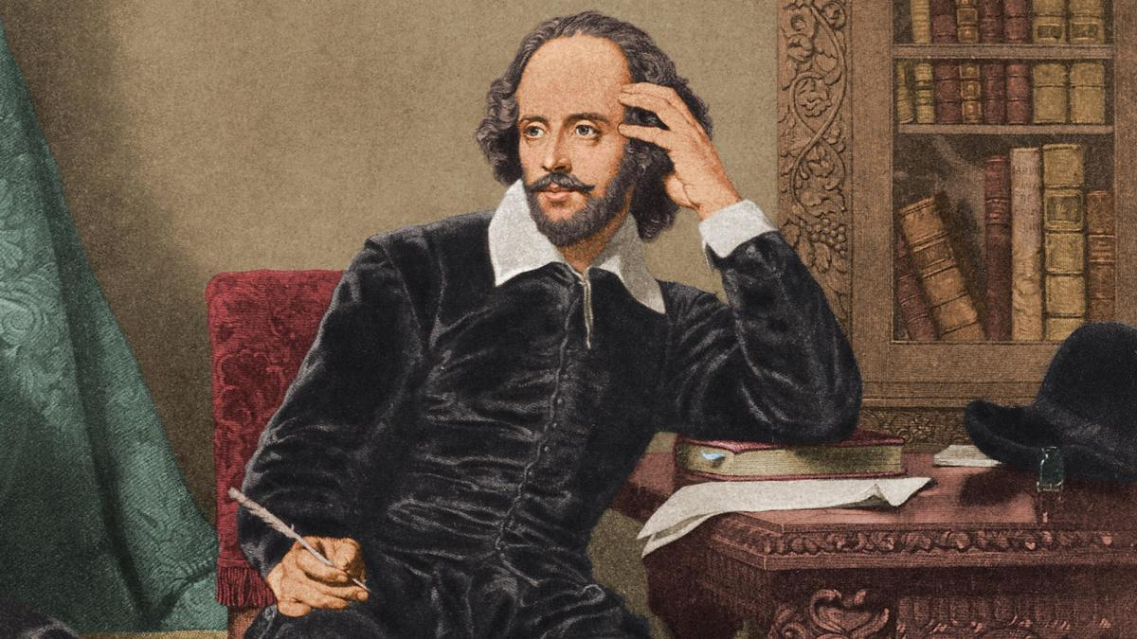
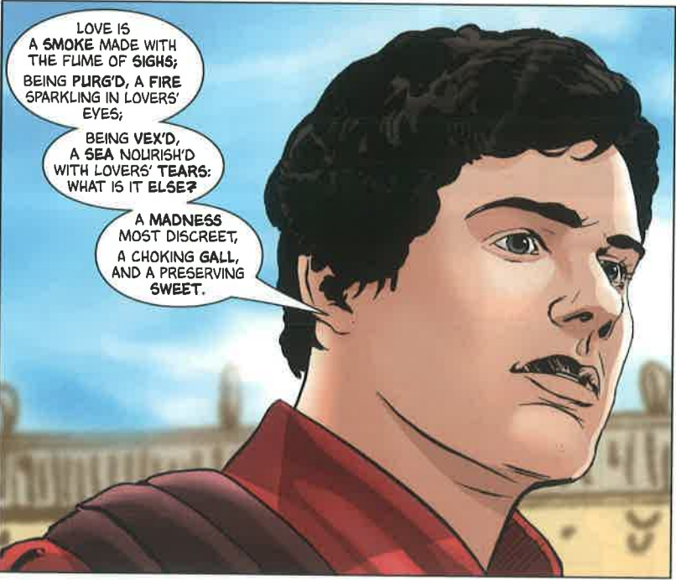
Shakespeare is not really remembered for his plots. Today’s audiences mostly focus on plot- twists, turns etc. often are the most important detail in a narrative.
But Shakespeare is famed for 3 main reasons:
Shakespeare’s Genius?
The beauty and control of his verse. Most of his plays are a form of poetry and his contribution to language is unparalleled.
Try writing two lines of Iambic Pentameter whilst also trying to say something meaningful. It’s hard. Shakespeare’s plays have almost 120,000 lines!
His ability to play with form and conventions. His audiences were far more aware of the conventions of poetry and tragic/comic theatre than most people today. But he was just as able to please the commoners as he was the rich and intellectual.
Can you think of any modern examples of stories that are both critically and commercially successful? That subvert audience’s expectations of genre and form?
His timeless characters. They may speak funny but his characters are as relevant and recognisable today as they were then.
Do you honestly not know anyone who has never been a bit like Romeo in this scene? I have met many introspective Hamlets, ambitious Macbeths, cunning Iagos, jealous Othellos, naive Mirandas, regretful Lears, stupid Bottoms and foolish Polonius’s in my time, as I’m sure you all will too.

Slide 20

A1.S1: Explain it to a Child!
But, dad explain to me:
What’s the bit with the men and the fighting all about?
What’s that Prince guy’s deal?
And Romeo? Why’s he such a sissy?
Well son, you see….
In your groups,split into three and each explain- to the child- what’s going on in
ACT I1 SCENE 1 & 2

